Slide 1


Slide 2
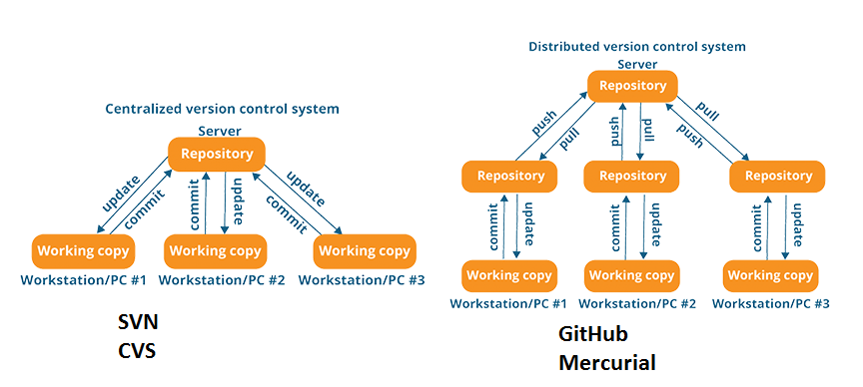

Slide 3


Slide 4
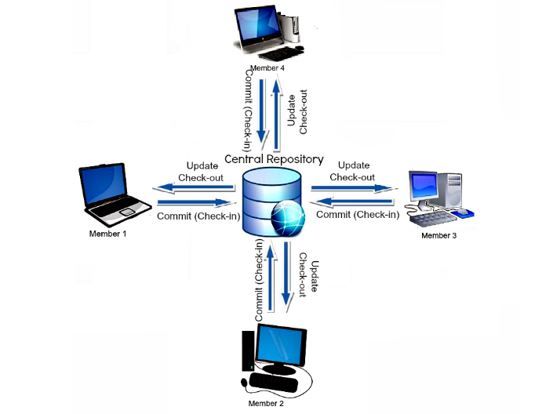

Slide 5
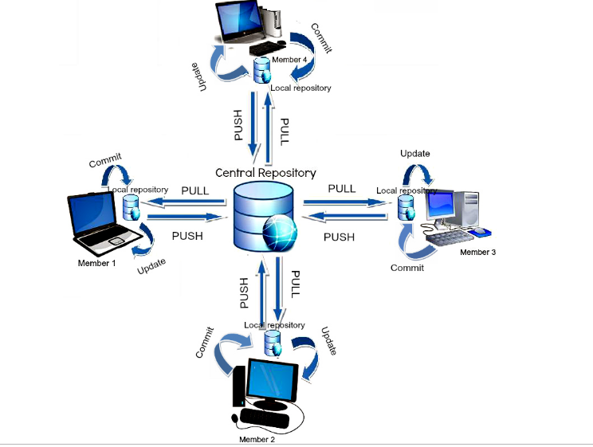

Slide 6
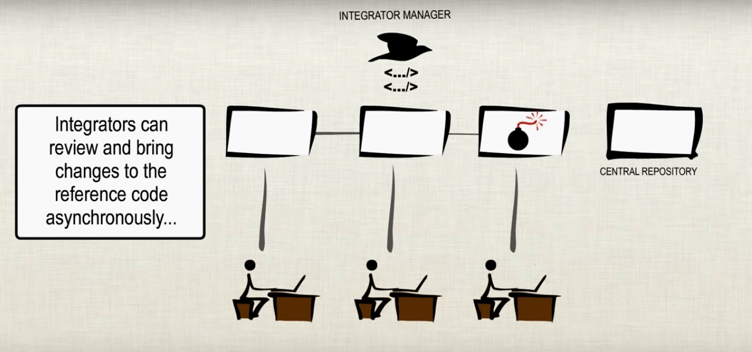

Slide 7
Uses Of GitHub :
It is a Collaboration Tool.
It is Cloud Hosting Platform.
Version Control System.
Feature Branch Creation and Merging the branches very simple.
We can Store the History ,Logs and Tags information.
Providing 1GB of storage for each repository..
No need to maintain the Backup server .

Slide 8
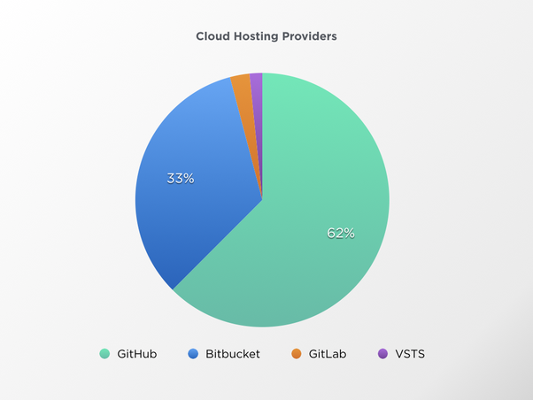

Slide 9


Slide 10


Slide 11
GitHub Content :
GitHub Overview
Centralized Vs Distributed Version Control System
GitHub Account Creation and Installation
Organization and Repository Creation
Life Cycle
Branch’s Creation
Forking & Webhooks
SSH creation and config setup
Pulling/Pushing/Merging/Stash/logg/etc.
User Administration & Maintenance
Issue Creation & Tracking with GitHub (As a Ticketing Tool)
Wiki Page Creation
Import Repository & New Gist
Tag Creations
Git Rebasing

Slide 12
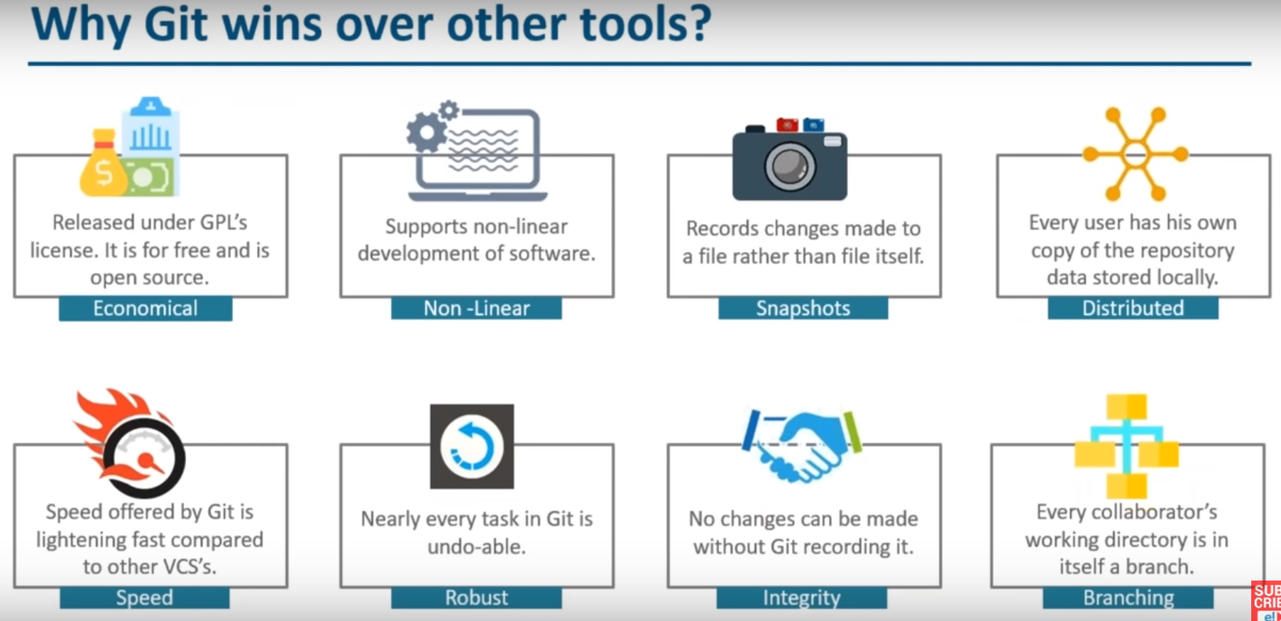

Slide 13
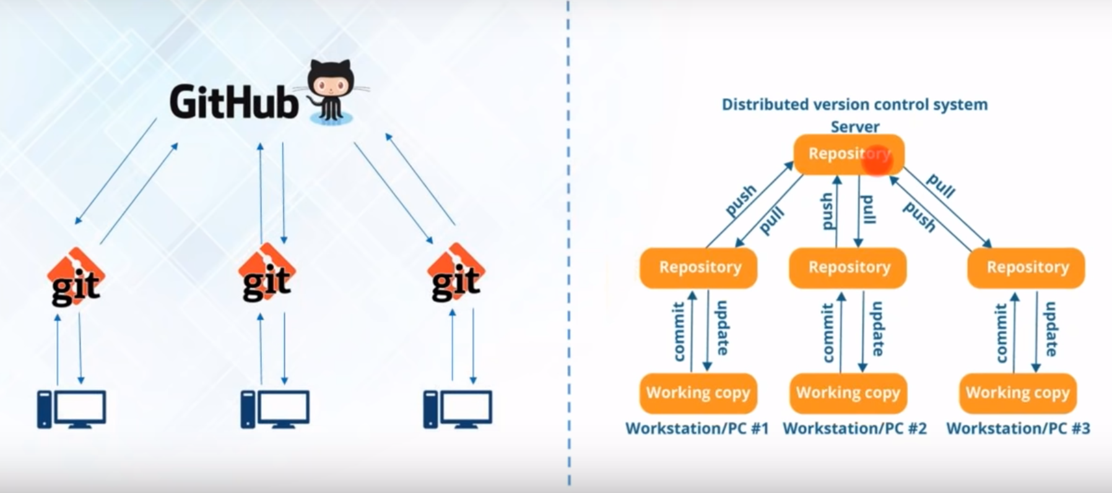

Slide 14
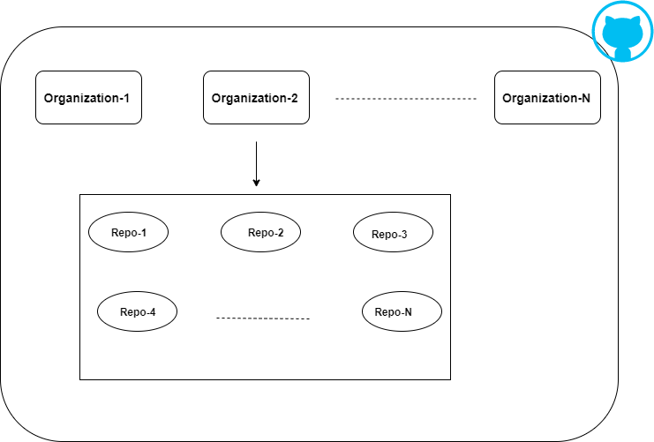

Slide 15
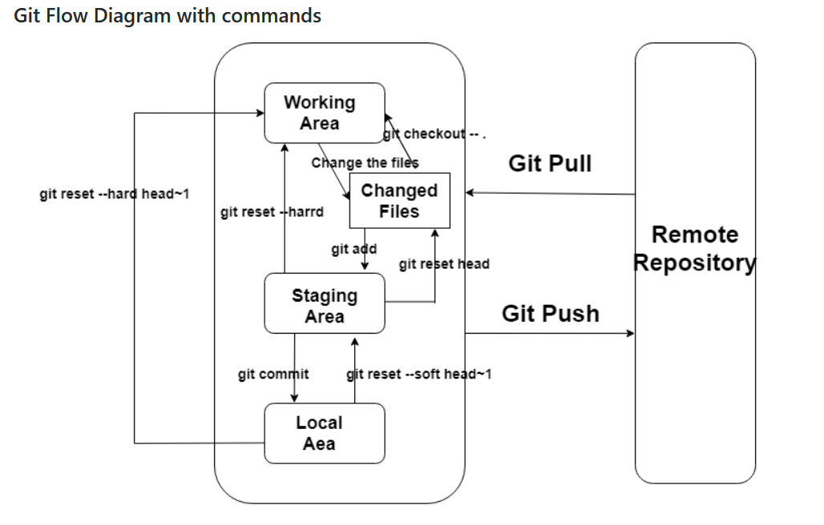

Slide 16
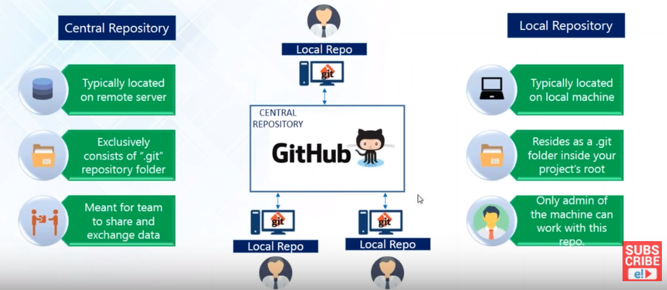

Slide 17
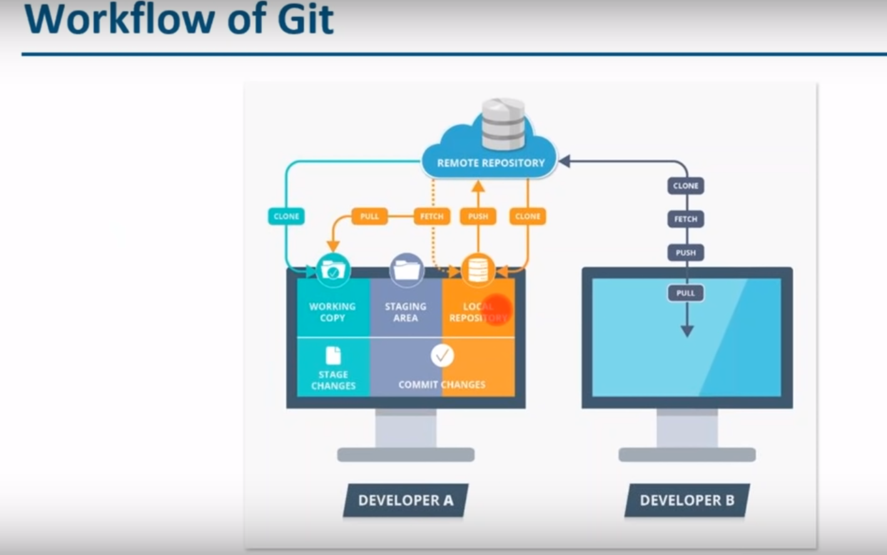

Slide 18
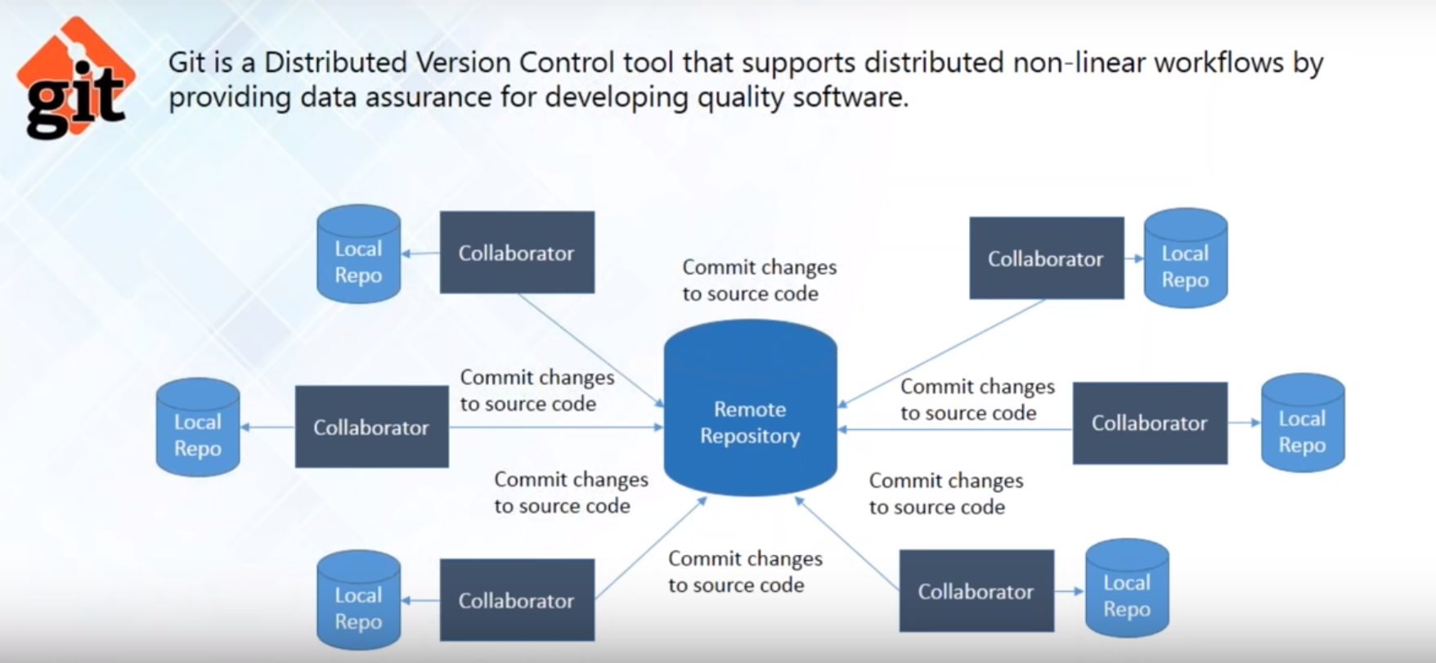

Slide 19
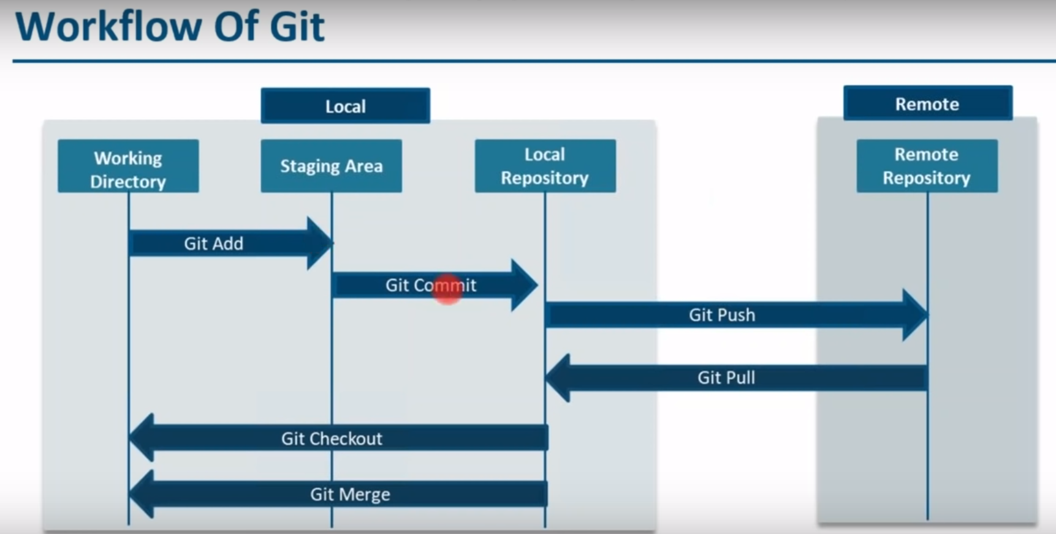

Slide 20
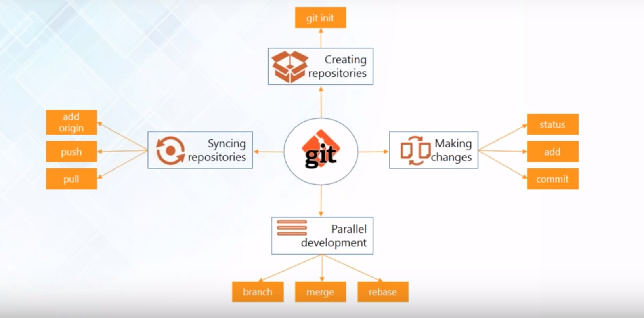

Slide 21
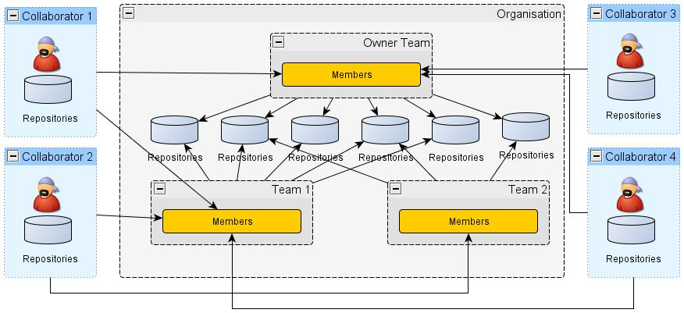

Slide 22
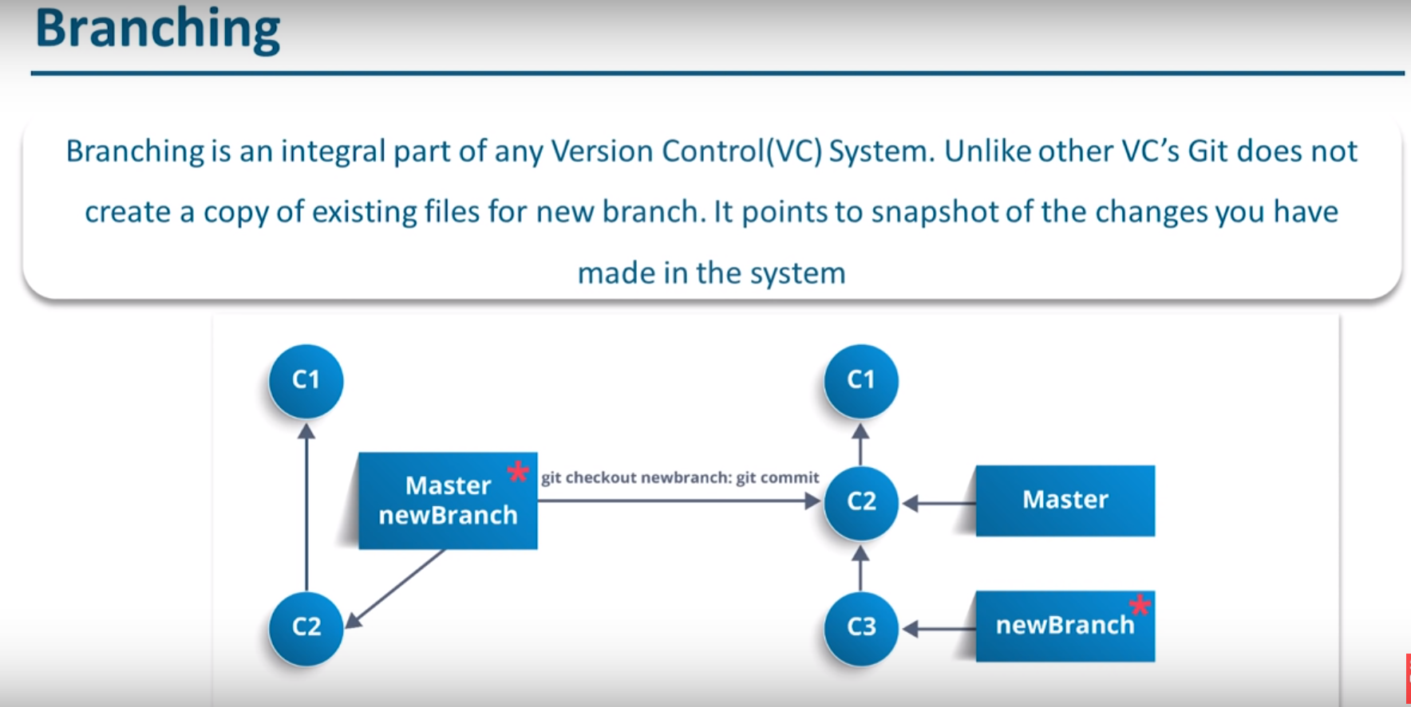

Slide 23
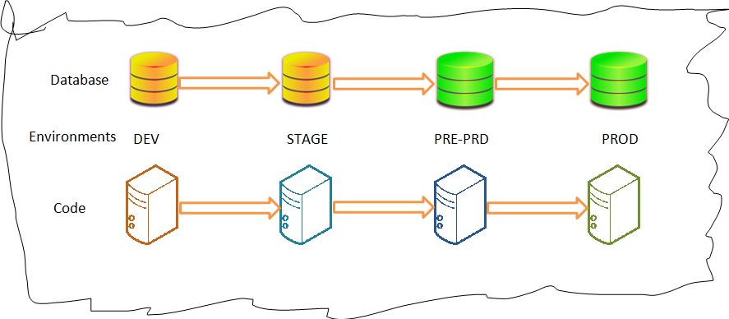

Slide 24
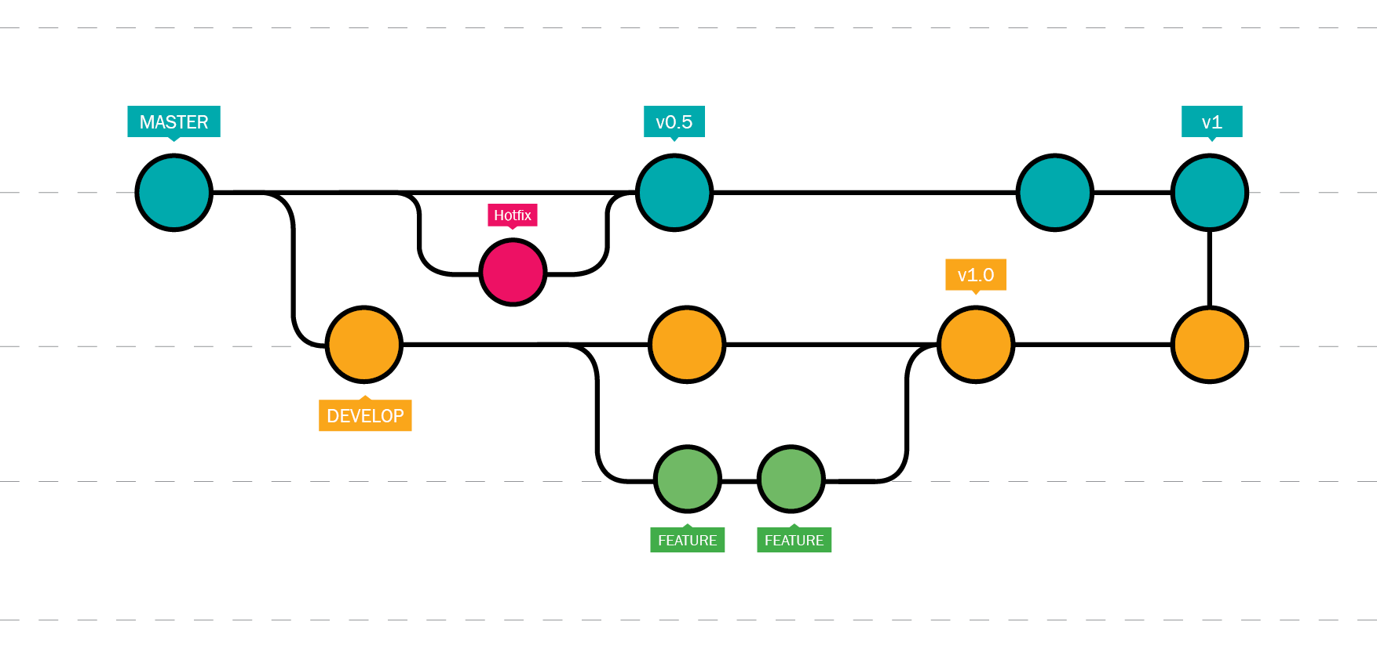

Slide 25
